Slide 1
What is KubeVirt ?
Kubernetes Based RHV
2017.0331 yzhao@redhat.com
Notes:
The slide is the simple introduction for kubevirt. Anyone who has advice ,please tell me and I will improve this. Thanks for all.
Email : yzhao@redhat.com
IRC : yzhao@ , #S1

Slide 2
About Kubernetes
Kubernetes is an open source system for manage containerized applications across multiples hosts, providing basic mechanisms for deployment, maintenance, and scaling of applications.
Kubernetes works based Go and Docker environment.
Notes:
About Kubernetes.

Slide 3
About KubeVirt
KubeVirt is a virtual machine management add-on for Kubernetes. The aim is to provide a common ground for virtualization solutions on top of Kubernetes.
Now, KubeVirt extends Kubernetes by adding additional virtualization resource type (especially the VM type) through Kubernetes’s third party resource concept. By using this mechanism, the Kubernetes API can be used to manager these VM resource alongside all other resources Kubernetes provides.
Notes:
KubeVirt Extended Kubernetes, especially the VM type.

Slide 4
KubeVirt Extended
Does what different from Kubernetes:
Create a predefined VM
Schedule a VM on a Kubernetes cluster
Launch a VM
Stop a VM
Delete a VM
* Use Cockpit to manage resource like hosts, VMs ,logs, services, pods...
Notes:
Today, KubeVirt works on these scenarios.

Slide 5
Example flow : Create and Delete a VM
A client posts a new VM definition to the K8s API Server
The K8s API Server validates the input and creates a VM 3rd party resource (TPR) object.
The virt-controller observes the creation of the new VM object and creates a corrsponding pod.
Kubernetes is scheduling the pod on a host
The virt-controller observes that a pod for the VM got started and updates the nodeName field in theVM object. Now that the nodeName is set, the responsibility transitions to the virt-handler for any further action.
The virt-handler (DaemonSet) observes that a VM got assigned to the host where it is running on.
The virt-handler is using the VM Specification and creates a corresponding domain using the local libvirtd instance.
A client deletes the VM object through the virt-api-server.
The virt-handler observes the deletion and turns off the domain.
Notes:
Example flow to create and delete a VM.

Slide 6
End Goal Architecture
oVirt Engine
Network Controller
Virt Controller
Storage Controller
VMState (etcd)
Kubernetes
Pod running VM
Libvirt
VM Launcher
qemu-kvm
VM Manager
Notes:
The end goal architecture.

Slide 7
Legend
Network Controller
Handles network related logic which is missing elsewhere
Storage Controller
Handles storage related logic which is missing elsewhere
VMState (etcd)
Keeps VM definitions, used for requests and updates.
Virt Controller
Relevant portions of Engine logic for abstracting virt over Kubernetes
VM Launcher
A simple process used to launch QEMU and handle basic interrupts
VM Manager
Handles VMs at the host level. Should cover for various VM related actions.

Slide 8
Flow
Client K8s API VM TPR Virt Controller VM Handler -------------- ----------- ------- ---------------- ---------- listen <----------- WATCH /vms listen <---------------------------- WATCH /vms | | POST /vms ---> validate | | create ---> VM ---> observe -------> observe | | v v validate <--------- POST /pods defineVM create | | | | | | | schedPod ---------> observe | | | v | validate <--------- PUT /vms | update ---> VM --------------------> observe | | | launchVM DELETE /vms -> validate | | | delete ----> * --------------------> observe | | shutdownVM
Notes:
Create and delete a VM .

Slide 9
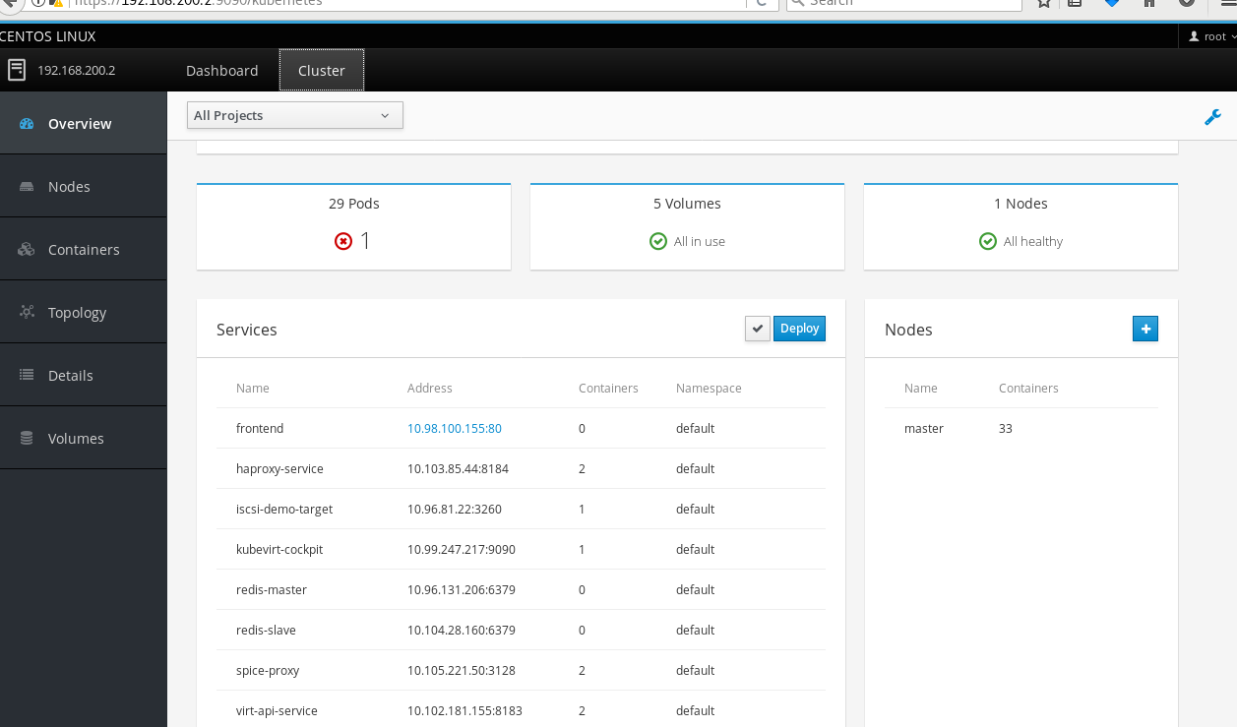
Cockpit--resource like pods, logs, services…
Notes:
Use Cockpit to manage and monitor the resource like pods, services, logs, containers…, rather than kubernetes dashboard.

Slide 10
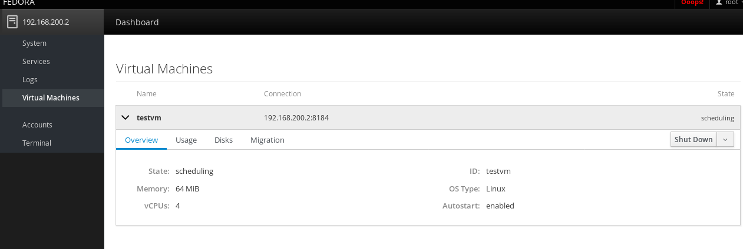
Cockpit-- VMs
Notes:
Use another port on KubeVirt Cockpit to manage and monitor the VMs.

Slide 11
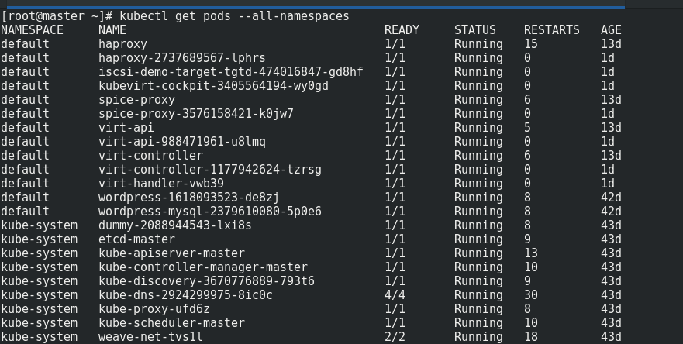
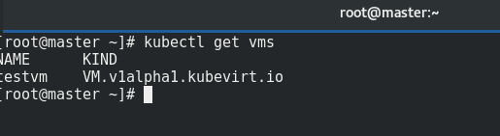
Master, Terminal -- pods, VMs
Notes:
Terminal to check the pods and VMs.

Slide 12

Simple App Example
Notes:
Simple app example deploy in the pods via KubeVirt like Kubernetes.

Slide 13
Try KubeVirt
Follow the Github : https://github.com/kubevirt/kubevirt/blob/master/docs/getting-started.md
Github: https://github.com/kubevirt/kubevirt
If any problems, discuss with me and improve together.
Notes:
You can have a try.

